Slide 1
Analysis of telecom project
Exploratory data analysis(data cleaning,univariate and bivariate analysis,report)i.emore details in the python ipynb files and visualize the all data
Segmentation of telecom (demographic segmentation,marketing segmentation) with 2-group cluster
Classification of actual and predicted customer segmentation and report

Slide 2
actual status
Churn and active are equal porportions of customer in the data
Predicted status
Active customers may increased in industry that means in future customer can churn less

Slide 3
GENDER REPORT
1.The chart shows that 49% customers are male.
2.The female accounts for about 39%.
3.The 12% customers are not identified of being male and female

Slide 4
Site type desc
The chart shows that there are 42% of customers who are using space way technology
More than half of the customers are concentrated more in the broadband remote ,therefore leads to its greatest use by the customers.

Slide 5
Marital status
The chart shows that there are 38%of the customers who are single.
There are only 37% of the customers who are married.
There are 5% of the customers who are identifies as divorcees.

Slide 6
the customers who give good feedback are account for 51%.
The customers who are bad at giving good feedback are account for 40%.
Therefore more of the customers are good at giving feedback and enjoy to be in the company.

Slide 7
there are 43% of customers who do not have computer.
There are 32% of customers who have computer
Therefore this chart shows that no. of customers having computer is less than the customers who do not have.

Slide 8
The chart shows that how many customers uses indirect channel and direct channel.
There are 70% of the customers who are using direct channel.
Only 26% of the customers are using indirect channel.
Therefore customer prefer direct channel over indirect channel.

Slide 9
The analysis shows that different customers prefer different plans.
In the analysis large number of customers prefer professional plan which is 25%.
On the other hand So plan and power plan are the least prefer by customer which is 6% and 9%.
Other plans like basic ,elite and home plan are in great preference.

Slide 10
The chart shows that large number of customers like retail/others sales channel which is 29%.
Other sales channel like call center , web orders ,and vars are also liked by customers which is 15%,14% and 14%.

Slide 11
Segmentation of Telecom industry
With 2-group cluster

Slide 12
Segmentation of model report
The ratio of customer of using model DW4000,DW6000,DW70000,HN9000 are more in group1 than in group 0.
The ratio of using model like DW4020,HN70005 and UNK are more in group0 than in group1.

Slide 13
Segmentation of gender
The chart shows that the ratio of male in in group1 is more than group0
But the ratio of female in group1 is less than group0.
Therefore male in group1 and female in group0 are in great ratio.

Slide 14
Segmentation of marital status
the ratio of unmarried in group 0 is more than group1.
The ratio of married people in group0 is more than in group1.
Whereas the ratio of divorcees are the same in both the groups.

Slide 15
Segmentation of children status
The chart shows that the ratio of people having at least one child are more in group1 than in group0 .
The ratio of people having more than one child are more in group1 than group0.

Slide 16
Segmentation of service plan status
The chart shows that the ratio of customer using professional plan is same in both the groups.
The ratio of home plan is almost same in both the groups.
The ratio of SO plan and elite plan is more in group1 than in group0.
Whereas the ratio of power plan and basic plan are more in group0 than in group1.

Slide 17
Segmentation of sales channel status
The ratio of customers who uses retail/others are more in group1 but almost same as in group0.
The ratio of customer using vars and web orders are more in group0 than in group1.
The ratio of people of using call center is more in group1 than in group0.

Slide 18
Segmentation of channel status
The chart shows that the ratio of direct channel is more in group0 than in group1.
The ratio of indirect channel is more in group 1 than group0.
Hence there is more preference of direct channel than indirect channel.

Slide 19
Segmentation of feedback status
The chart shows that the ratio of customers who are good at giving feedback are more in group1 than in group0.
The ratio of customer who are bad at giving feedback are more in group0 than in group1.

Slide 20
Segmentation of site-type desc status
The ratio of customers who uses broadband remote are more in group0.
The ratio of customer who uses spaceway are more in group1 than in group0.
Here in the chart use of both are same that is 100.

Slide 21
Segmentation of computer status
The ratio of customer who do not uses computer are more in group0 than in group1.
The ratio of customers who are having computers are more in group1 than in group0.
Hence ratio of not having computer is more than having computer.

Slide 22
Classification of telecom project

Slide 24
Variables selection under random model
We have to choose so many variables in the data but we have to see that in the data not necessity that variables we have get only 23 variables perform same accuracy no change in accuracy our model has overfitting the problem we have to reduced it then works fine

Slide 27
Service plan report
Service plan factors are churned
We have seen that the telecom data analysis of plan where actual customer are less churned as compared to predicted customer.
We have seen that in the graph home plan and basic plan there will be more customers in future who will be more churned as compared to actual customers . To attract them we have to give different rewards like discounts, incentives , vouchers etc to our customers.
In actual SO customers there will be no active customers as compared to predicted SO plan.
3. Therefore our plans will be very productive in future except home and basic plan.
4. All other plans are performing better so customers will not churn.

Slide 28
Martial status actual customers
Martial status predicted customers

Slide 29
Marital status report
Marital factors are churned
We have seen that in the graph divorcee or widow does not bring a major affect in the market when we see its actual or predicted customers but we have to work on married and single martial status because both factors can affect the market and customers can leave in the future that’s why we have to work on it.

Slide 30
Site desc actual customers
Site desc predicted customers

Slide 31
Site desc report
Site desc factors are churned
We have seen that in the graph actual and predicted customers who are using broadband remote will more likely to leave in the future but spaceway customers will not leave the company as compared to broadband customers.

Slide 32
Feedback actual customers
Feedback predicted customers

Slide 33
feedback report
feedback factors are churned
1.The customers having bad feedback will churn less in future as compared to actual data .
2.The customers having good feedback and no feedback will churn more in future as compared to its actual data.

Slide 34
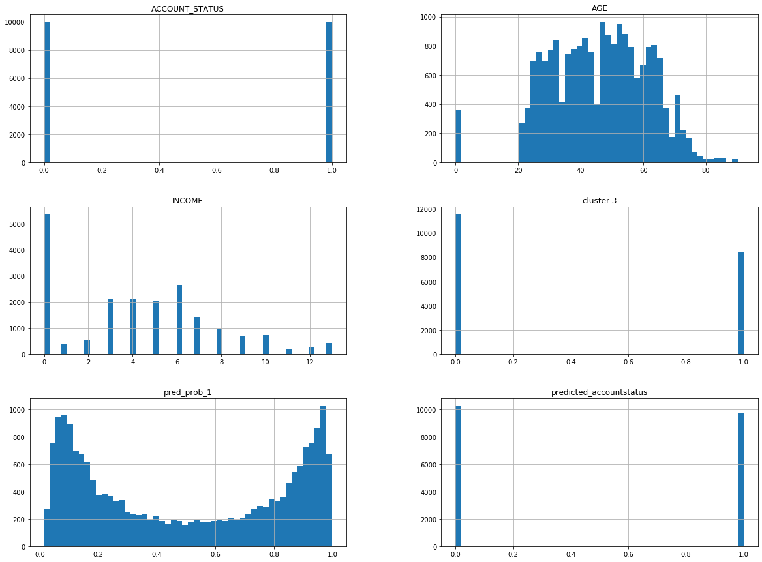

Slide 35
Computer actual customers
Computer predicted customers

Slide 36
computer REPORT
The customers who do not have computers will churn more in future as compared to actual data.
The customers who have computers will churn less in future as compared to actual data.
The customers who are not identified of having computer will churn less in future as compared to its actual data.

Slide 38
direct and indirect channel report
We have seen that in indirect and unknown channel the customers in future will be churned less which is advantageous for the company.
In direct channel the customer in future will be churned more making huge losses.
Therefore indirect and unknown channel is more efficient for the company.

Slide 39
Presence of children actual customers
Presence of children predicted customers

Slide 40
REPORT
The customers having atleast one children will churn less in future as compared to actual customers.
The customers having no children will churn more in future as compared to the actual customers.

Slide 41
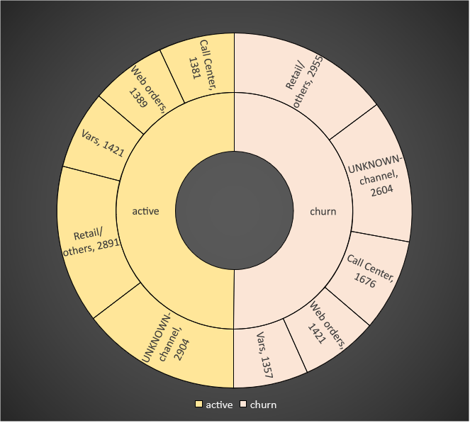
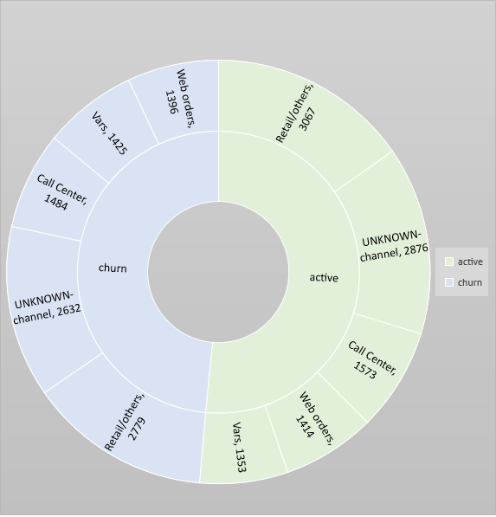
Sales channel actual customers
Sales channel predicted customers

Slide 42
sales channel REPORT
The customers who uses sales channel like retail/other, unknown channel will churn more in future as compared to actual data.
The customer who uses channel like call center , web orders , vars will churn less in future.
Therefore sales channel works efficiently for the company.

Slide 43
model actual customers
model predicted customers

Slide 44
Model report
The models like DW4000,HN70005,UNK will churn more in future as compared to actual data. Therefore these models lead to huge loss to the company.
The other models will churn less in future therefore profitable for the company.

Slide 45
Group of churning customers of actual and predicted
actual churn customer in 5 months
Predicted churn customer in 5 months

Slide 46
# If a group of customers have a 20% chance of churning this month, then we would expect them to remain customers for 5 months (1 month ÷ 20%).
# If the churn were reduced to 1%, then we would expect the customers to remain for 100 months.
#actual customers are churn in 1 month 513.750000 customers i.e 6.11% in group1 and group0 churn are 320.666667 2.76% customers and churning customers in a group after 5 months in group1 customers are churned 30.58% and group 0 customer are churned 13.82% in actual status
we have to conclude that after predicted status churn customer status after 1 month and 5 months status
#predicted customers are churn in 1 month 338 customers i.e 4.02% in group1 and group0 churn are 471 4.06% customers and churning customers in a group after 5 months in group1 customers are 20.12% and group 0 customer are churned 20.32% in predicted status
we have to conclude that churning customers are in group1 percentage is decreased i.e 30.58 to 20.12 in 5 months and group 0 percentage is increase by 8% this is not good in future group 0 customers can leave more just work on these customers and provide trhe incentives and discounts of group 0 customers

